Slide 1

A SYNOPSIS ON
“EMERGENCY ALARM”
Session: - 2018-2019
Guided by: Submitted By:
Shirish Nagar(Assistant Professor) Prachi Gupta(IV year- PCE/15/IT/032)
Poornima College of Engineering Shaily Rani (IV year- PCE/15/IT/049)
Email: shirishnagar@poornima.org S. Rajshree(IV year- PCE/15/IT/047)
DEPARTMENT OF INFORMATION TECHNOLOGY ENGINEERING POORNIMA COLLEGE OF ENGINEERING ISI-2,
RIICO INSTITUTIONAL AREA
SITAPURA, JAIPUR-302022
(RAJASTHAN)

Slide 2
TECHNICAL REQUIREMENTS
Tools :-
Version Control – Github
Database Management Tool – Firebase
IDE – Android Studio, Draw.io, Android SDK
Technologies :-
Android (version 3.1.2)
JAVA (Eclipse)

Slide 3
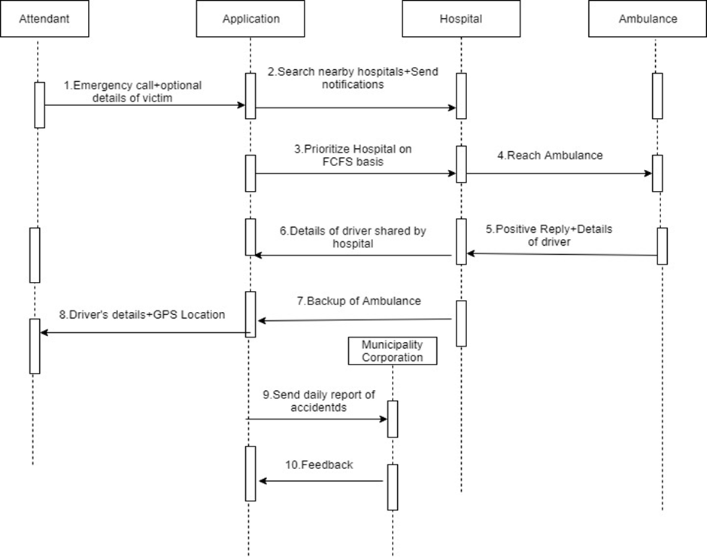
SEQUENCE DIAGRAM
5

Slide 4
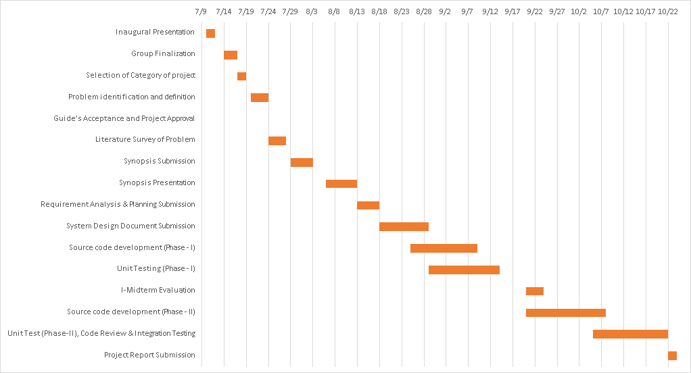

Slide 5
PROPOSAL
INTRODUCTION :-
Emergency alarm is an android application generally designed for overcoming the problems caused due to unavailability of ambulance at the time of accidents.
This application helps us in a way that whenever any accident occurs, we just need to connect to our application and it will send notification to hospitals in a range of 1-3 km and hospital will appoint ambulance on the basis of First Come First Serve with one backup.
The hospital will also get the details of the victim like his/her name, blood group, address (if available).
According to the details provided by the victim side, the ambulance sent by the hospital will have those basic hospitality facilities necessary for that victim.

Slide 6
SYNOPSIS
Objective Vision :
To overcome the problems caused due to unavailability of ambulance at the time of accidents.
Users :
Contacting person
Hospital
Ambulance Driver
Optional Features :
Details of the victim like name, address and blood group can be sent to the hospital.
Feedback for further improvement.
User Interface Priorities :
Professional look and feel
Application testing and support for Android phones
Reports exportable in any other desirable format

Slide 7
Functional and Non-Functional Requirements
Functional Requirements :
A system for helping victim by making an emergency call.
One can just tap on the button provided in the app to make emergency call.
The facility to see nearest hospital.
Hospital is choose on the basis of FCFS.
The facility with one backup ambulance.
Details of driver and its location is shared by the hospital.
Daily report of accidents is sent to Municipal Corporation.
Non-Functional Requirements :
The software will be user friendly ie. user can easily operate it.
24*7 availability.
The system will be secure as it will be dealing with delicate
The system should able to support GPS.

Slide 8
LITERATURE SURVEY
Got help and idea from the existing project i.e. “Call Emergency App”.
Read a case study report over “A Statistical Data Analysis of Road Traffic Accidents in Jaipur City”.

Slide 9
REFRENCES
https://bohatala.com/ambulance-management-system/
https://timesofindia.indiatimes.com
https://irjet.net/archives/V4/i10/IRJET-V4I10148.pdf
https://www.hindustantimes.com/jaipur/deaths-in-road-accidents-down-in-rajasthan/story-ljaXpRDekyxo885dN1NYpO.html

Slide 10
Thank You!!

